Slide 1
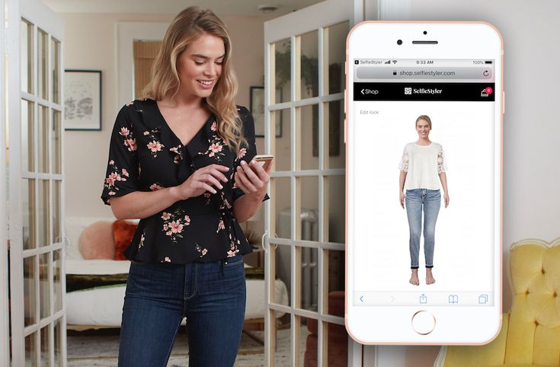
Virtual Stylist
Problem - This summer look is so gorgeous! how would it look on me?
Solution - A virtual stylist platform that would recommend similar products and let customers try on these items digitally
Approach -
1. Recommend similar fashion products
2. Virtual Try-On based on those products
Ref - https://in.pinterest.com/pin/345369865172616862/

Slide 2
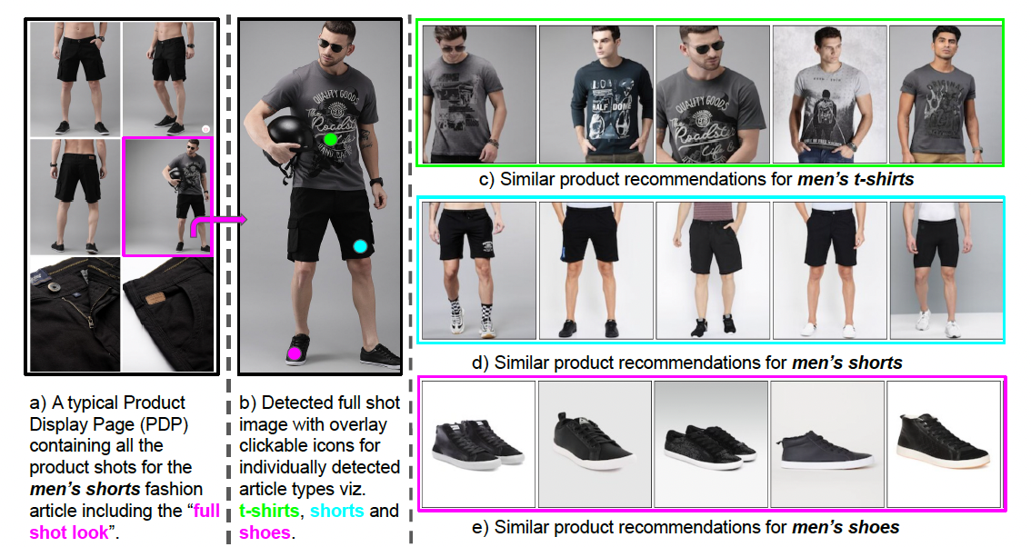
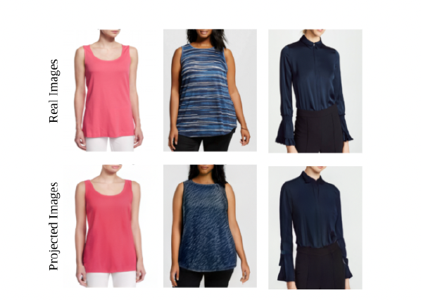
Prior Work
ShopLook -
Addresses the challenging problem of recommending similar fashion products
No TryOn
TryOnGAN -
A StyleGAN-based interpolation optimization algorithm for photo-realistic try-on
No Recommendation
Ref - Abhinav Ravi, Sandeep Repakula, Ujjal Kr Dutta, and Maulik Parmar.
Buy me that look: An approach for recommending similar fashion
products, 2021

Slide 3
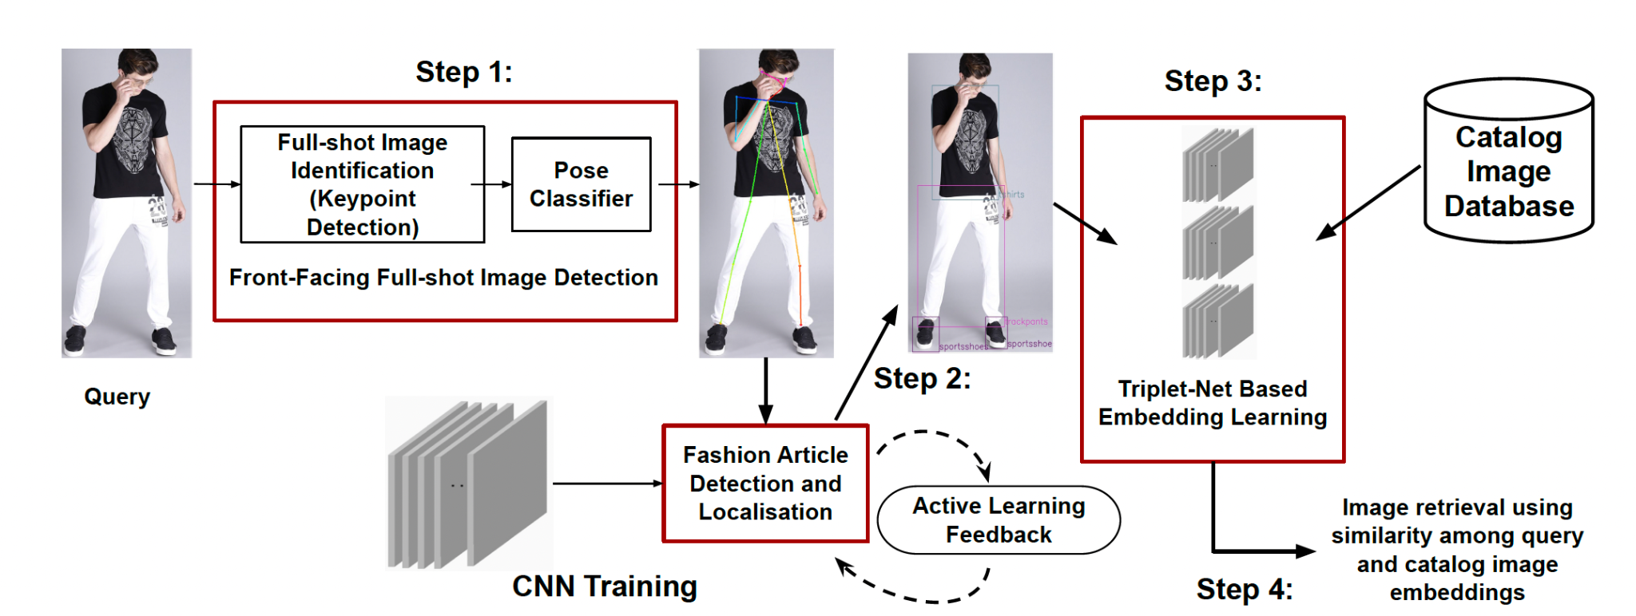
Method - Recommender Module
Pose classifier
Fashion Article Detection and localization
Embedding Generation for Article Types
Image Retrieval
Ref - Abhinav Ravi, Sandeep Repakula, Ujjal Kr Dutta, and Maulik Parmar.
Buy me that look: An approach for recommending similar fashion products, 2021

Slide 4
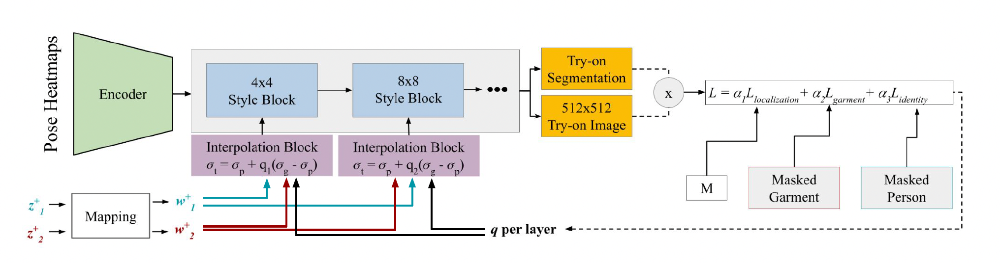
TryOn Module
PostNet- detects pose key points
Generator(style blocks) - produces segmentation image and an RGB image
Interpolation blocks- interpolates between the latent codes using the interpolation coefficients
The loss function - localization of fashion items, reproducibility of garment, and person’s identity
Ref - Kathleen M Lewis, Srivatsan Varadharajan, and Ira Kemelmacher- Shlizerman. Tryongan: Body-aware try-on via layered interpolation, 2021

Slide 5
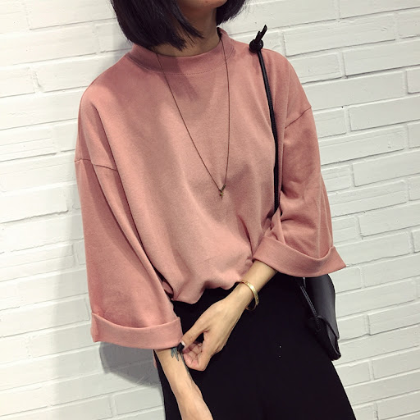
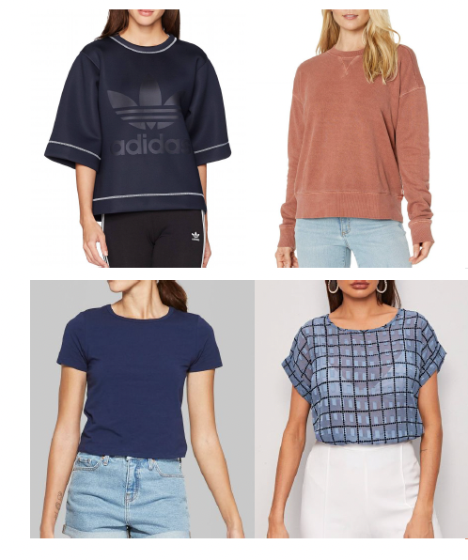
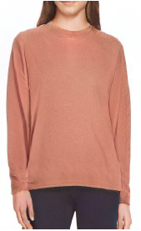
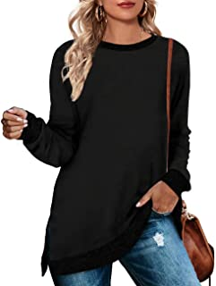
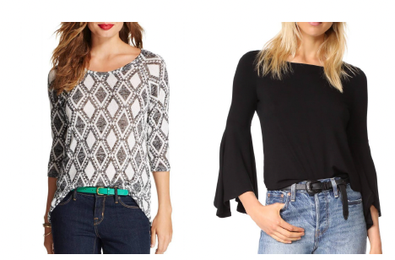
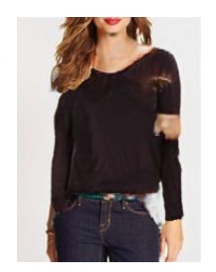
Outcome
Look image Recommended Product image Person image Generated image
Look image Recommended Product image Person image Generated image

Slide 6
Punch Lines
Challenges
disentanglement of person identity like skin color, body shape and product image
skin generation for shorter length of sleeves of product image
pre-processing the recommended image to feed that into try-on module
Application -
e-commerce giants like Amazon, Macy’s, Walmart, Gap, Nordstrom, etc. to provide customers with a platform to try out different fashion looks, outfits based on a customer image and a style image
end-to-end virtual recommendation based try-on platform

